Slide 1
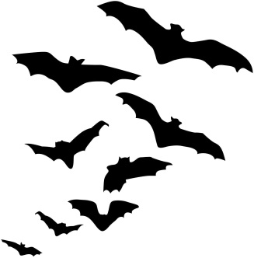
Ravens Hallowe’en quiz!

Slide 2
Round 1 – Pumpkins!
Q1: “Punkin Chunkin” is a sport where teams compete to see who can throw pumpkins the furthest through mechanical means. The Guinness world record shot was set in 2011 by a pneumatic cannon dubbed "Big 10 Inch", but how far did they shoot a pumpkin?
A – 972m
B – 1431m
C – 1690m

Slide 3
Round 1 – Pumpkins!
Q2: China is the country which produces the most pumpkin per year, at 7,838,800 tons. However, which country in the top 12 pumpkin producing countries according to some website I found produces the most pumpkin per capita?
A – Cuba
B – Ukraine
C – Spain

Slide 4
Round 1 – Pumpkins!
Q3: The world record for heaviest pumpkin was set by Mathias Willemijns (Belgium) and authenticated by the Great Pumpkin Commonwealth (GPC) in Ludwigsburg, Germany, on 9 October 2016. How big was this pumpkin?
A – 1054.01 kg
B – 1190.49 kg
C – 1276.84 kg

Slide 5
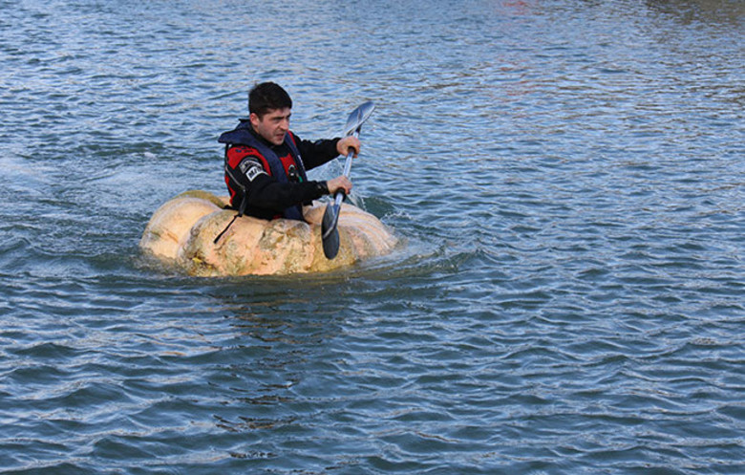
Round 1 – Pumpkins!
Q4: This is Dmitri Galitzine, winning the Guinness World Record for fastest 100m paddled in a pumpkin: 2 minutes 0.3 seconds. How much did this pumpkin weigh?

Slide 6
Round 1 answers
Q1: C – 1690m
Q2: A – Cuba, with 46.24 kg per person
Q3: B – 1190.49 kg
Q4: 272.16 kg (point for 260-285 kg)

Slide 7
Round 2 – Folklore
Q1: If you are invited into a fairy mound, what must you never do?
A – Eat or drink anything
B – Speak to the fairy queen
C – Take your shoes off

Slide 8
Round 2 – Folklore
Q2: Why did the tradition of fancy dress for Hallowe’en begin?
A – To wear warm layers (such as animal furs) in the cold weather
B – As a disguise to play tricks on neighbours
C – So that if evil spirits see you, they think you’re one of them and leave you alone

Slide 9
Round 2 – Folklore
Q3: According to Romanian legend, what can you find using a 7-year-old boy riding a white horse?
A – A vampire’s grave
B – The entrance to the underworld
C – Ancient burial mounds

Slide 10
Round 2 – Folklore
Q4: Why would a young woman be peeling an apple on Hallowe’en?
A – To bring good fortune for the following harvest
B – To find out who she would marry
C – To make it easier to bite into when apple bobbing

Slide 11
Round 2 – Folklore
Q5: What did the ancient Greeks do to reduce the risk of zombies?
A – Baked bread immediately after the funeral
B – Buried their dead under heavy rocks so they couldn’t escape
C – Sprinkled salt at the entrances to their homes

Slide 12
Round 2 answers
Q1: A – no eating or drinking with the fairies or you’ll be stuck there forever
Q2: C – dress up to confuse the evil spirits
Q3: A – he must be dressed in white at midday, the horse will stop at the vampire’s grave
Q4: B – throw the peel over your shoulder to see the initial of your future love
Q5: B – heavy objects on top of dead bodies stop them going anywhere

Slide 13
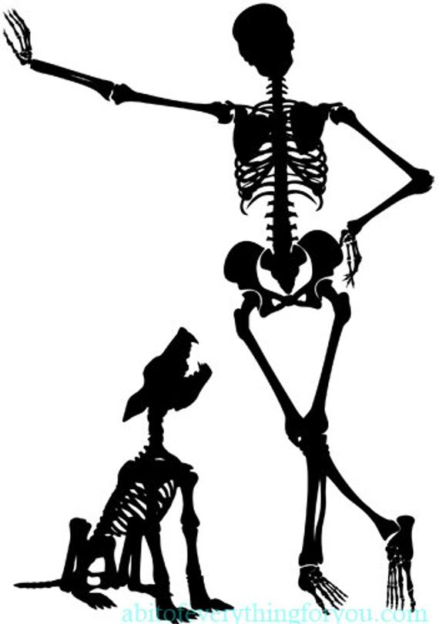
Round 3 – World records
Q1: In 2011, where was the largest gathering of skeletons?
A – Tokyo Disneyland, Japan
B – Cultural centre, Toluca, Mexico
C – Swansea University, UK

Slide 14
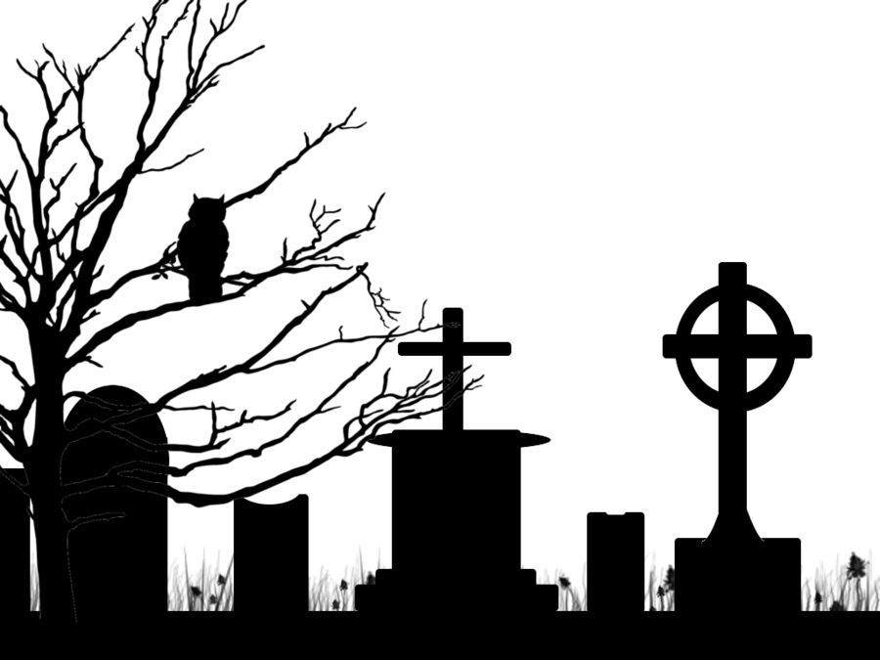
Round 3 – World records
Q2: How old is the oldest ghost, Vivaron the snake-demon, who resides at Ghost Ranch, New Mexico?
A – 220 million years old
B – 990,000 years old
C – 5000 years old

Slide 15
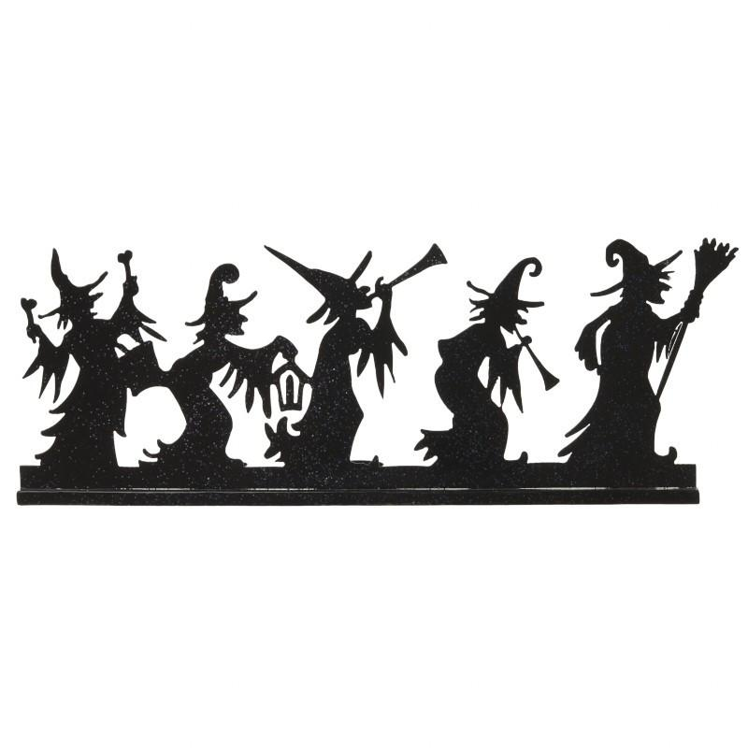
Round 3 – World records
Q3: The largest gathering of witches (1607 of them!) was in Spain in Nov 2013, but why did they gather?
A – For a convention on broom maintenance
B – To curse the prime minister, Mariano Rajoy
C – To bring them luck for the Christmas lottery

Slide 16
Round 3 – World records
Q4: How big is the largest model of Hogwarts?
A – 50ft (15m) across
B – 10ft (3m) across
C – 5ft (1.5m) across

Slide 17
Round 3 – World records
Q5: How many people were at the Great Wolf Lodge in Canada to break the record for most number of people wolf howling together?
A – 296
B – 803
C – 1437

Slide 18
Round 3 answers
Q1: C – Swansea skeletons (2018 in total)
Q2: A – 220 million years old, they found a fossil of the “ghost” phytosaur
Q3: C – witches wanted riches!
Q4: A – 50ft across, made by Warner Bros. Art Department and contains more than 2500 fibre optic lights
Q5: B – 803 (the first 150 got free wolf ears)

Slide 19
Round 4 – Would you survive?
Q1: What would you be trying to kill/get rid of if you buried a glass bottle filled with urine, bent pins, hair, and rosemary?
A – Witch
B – Demon
C – Goblin

Slide 20
Round 4 – Would you survive?
Q2: According to folklore, what will kill a werewolf?
A – Silver
B – Running water
C – Nothing

Slide 21
Round 4 – Would you survive?
Q3: In Mary Shelley’s novel, how did Frankenstein’s monster intend to die?
A – Throw himself off a cliff
B – Drown himself in the freezing waters of the Arctic circle
C – Set himself on fire

Slide 22
Round 4 – Would you survive?
Q4: How does salt stop a vampire chasing you?
A – It burns their skin
B – The vampire has to stop to count every grain while you escape
C – The salt summons the devil who will kill the vampire

Slide 23
Round 4 – Would you survive?
Q5: If Aka Manto (a Japanese demon) appeared while you were in the bathroom, what terrifying question would he ask?
A – “When did you cut your fingernails?”
B – “How many children do you have?”
C – “Would you like a red or blue cloak?”

Slide 24
Round 4 answers
Q1: A – witch bottles
Q2: C – silver was made up for 1941 film “The Wolf Man”, running water is for undead things
Q3: C – he leaves the boat to burn himself at the North Pole
Q4: B – birdseed or sand may also work, anything that takes a while to count
Q5: C – but you’ll die whichever you choose…

Slide 25
Round 5 – Hallowe’en films
Q1: How many people has Michael Myers killed in total (across all 10 “Halloween” films)?
A – 79
B – 121
C – 193

Slide 26
Round 5 – Hallowe’en films
Q2: Which member of the royal family is/was a fan of The Rocky Horror Picture Show?
A – The Queen
B – Prince William
C – Princess Diana

Slide 27
Round 5 – Hallowe’en films
Q3: Which film did Tim Burton NOT direct?
A – The Nightmare Before Christmas
B – Frankenweenie
C – The Corpse Bride

Slide 28
Round 5 – Hallowe’en films
Q4: Which was the first film based on a Stephen King story?
A – Children of the Corn
B – Carrie
C – The Shining

Slide 29
Round 5 – Hallowe’en films
Q5: What is the highest rated horror film on Rotten Tomatoes?
A – Us (2019)
B – A Quiet Place (2018)
C – The Cabinet of Dr. Caligari (1920)

Slide 30
Round 5 answers
Q1: B – apparently the timelines are confusing?
Q2: C – “it quite completed my education”
Q3: A – he was the producer, Henry Selick directed it
Q4: B – Carrie was made in 1976
Q5: A – ranked at #1 but has a lower % score than the others, I have no idea how their ranking works

Slide 32
https://www.facebook.com/andrewismusic/videos/1246052922083739/

